Slide 1
Chapter no.4
Image transforms

Slide 2
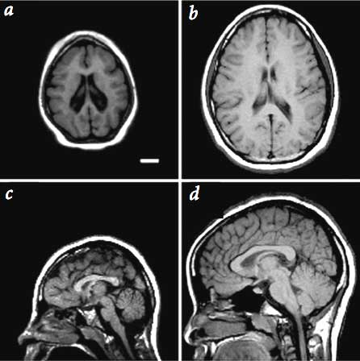


Why transform?
Better image processing
Take into account long-range correlations in space
Conceptual insights in spatial-frequency information.
what it means to be “smooth, moderate change, fast change, …”
Fast computation: convolution vs. multiplication
Alternative representation and sensing
Obtain transformed data as measurement in radiology images (medical and astrophysics), inverse transform to recover image
Efficient storage and transmission
Energy compaction
Pick a few “representatives” (basis)
Just store/send the “contribution” from each basis
?

Slide 3
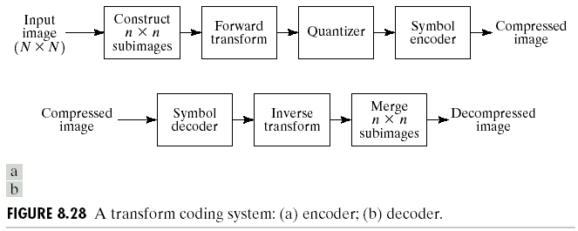
Basic Process of Transform Coding
Figure is from slides at Gonzalez/ Woods DIP book website (Chapter 8)

Slide 4
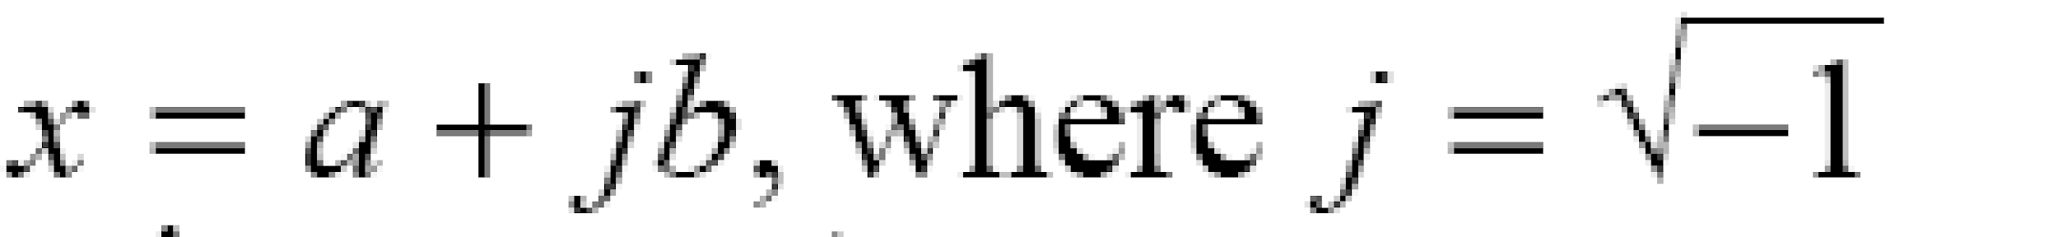
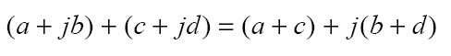
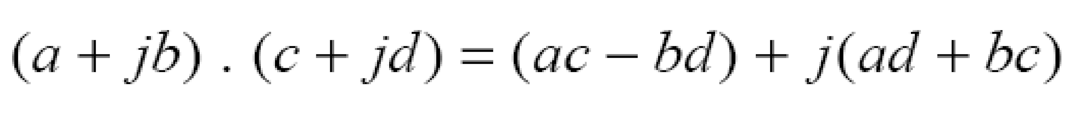
Mathematical Background:
Complex Numbers
A complex number x is of the form:
α: real part, b: imaginary part
Addition:
Multiplication:

Slide 5
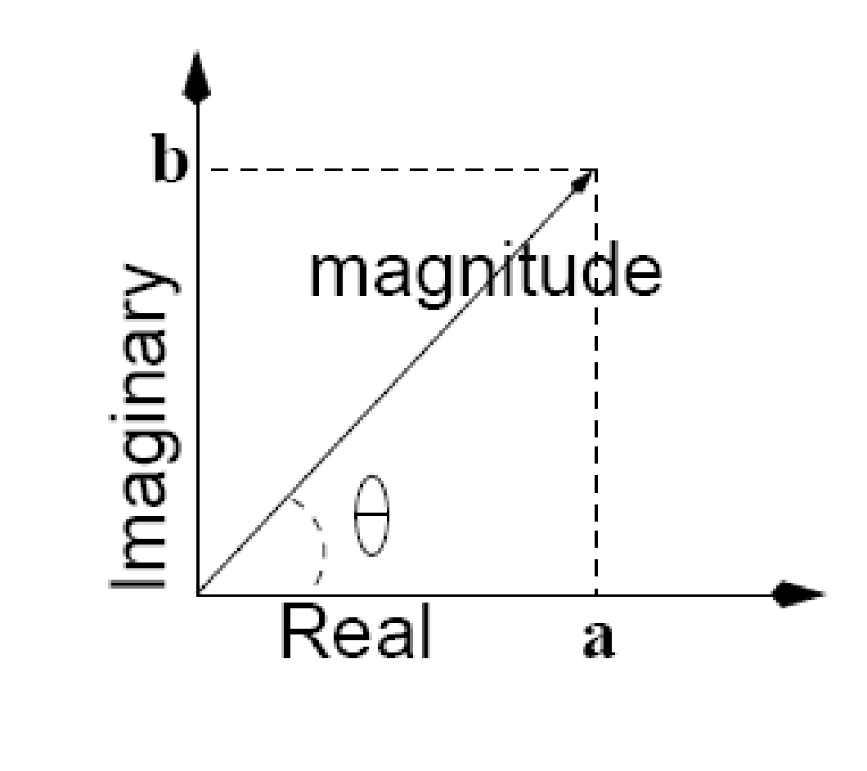
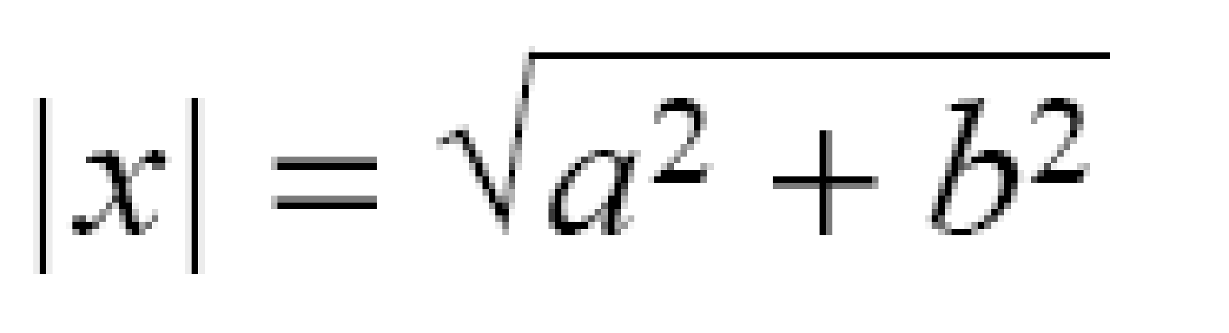
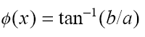
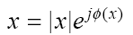
Mathematical Background:
Complex Numbers (cont’d)
Magnitude-Phase (i.e.,vector) representation
Magnitude:
Phase:
φ
Magnitude-Phase notation:

Slide 6
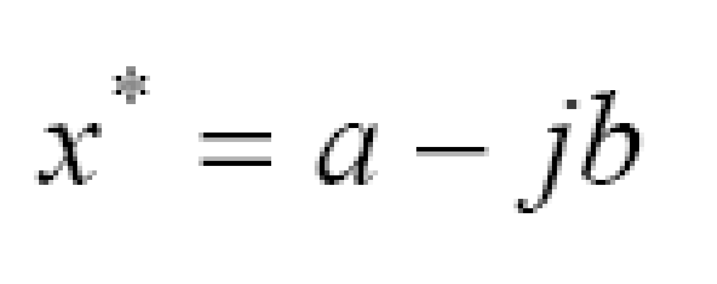
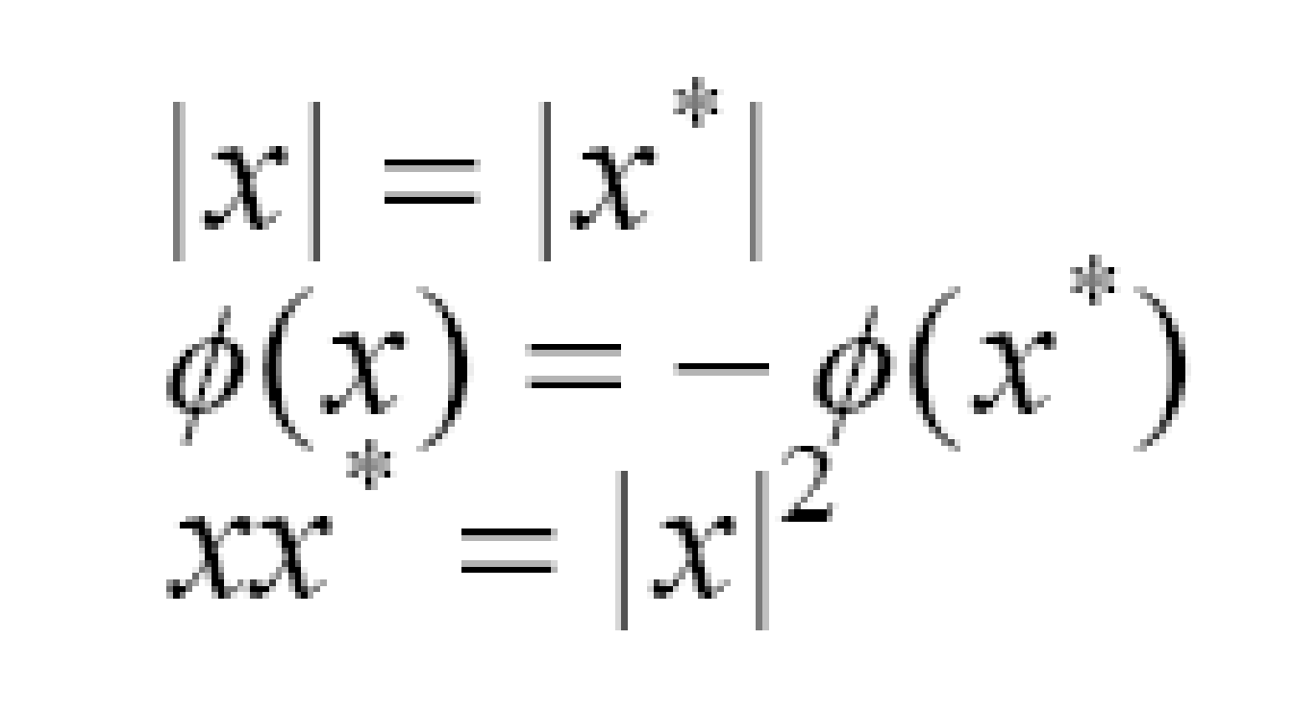
Mathematical Background:
Complex Numbers (cont’d)
Multiplication using magnitude-phase representation
Complex conjugate
Properties

Slide 7
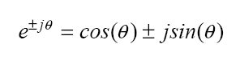
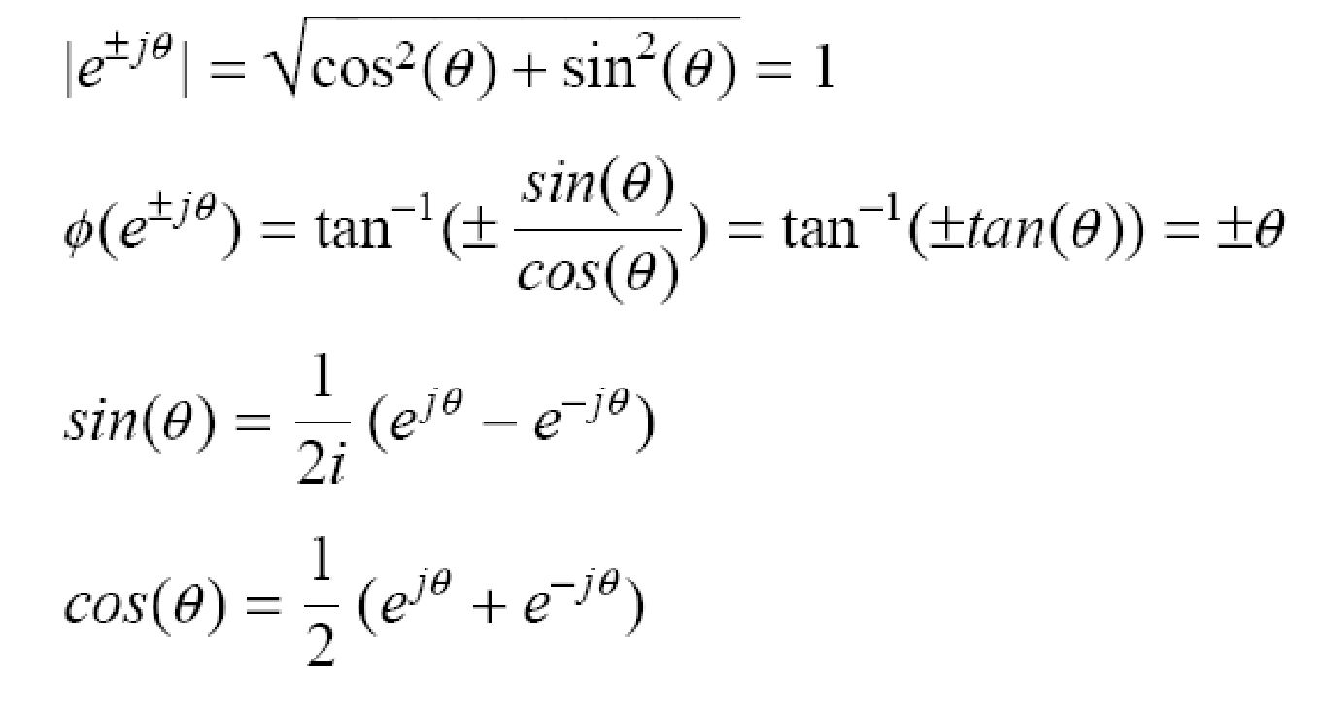
Mathematical Background:
Complex Numbers (cont’d)
Euler’s formula
Properties
j

Slide 8
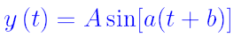
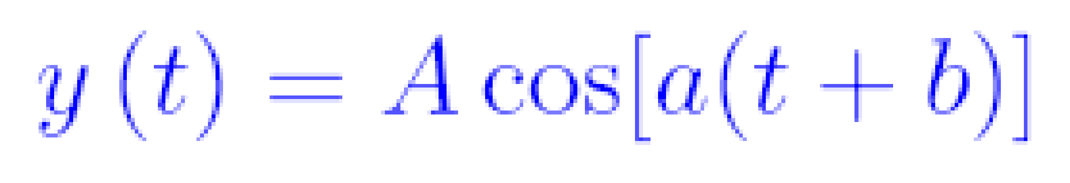
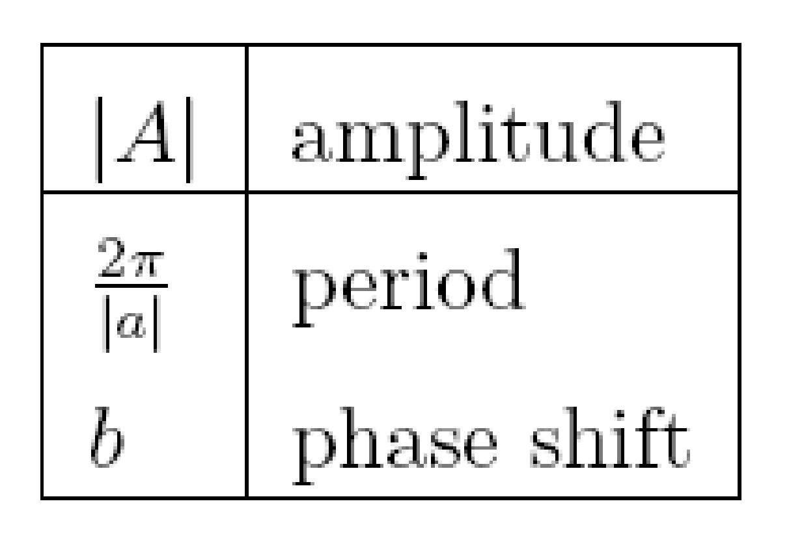
Mathematical Background:
Sine and Cosine Functions
Periodic functions
General form of sine and cosine functions:

Slide 9
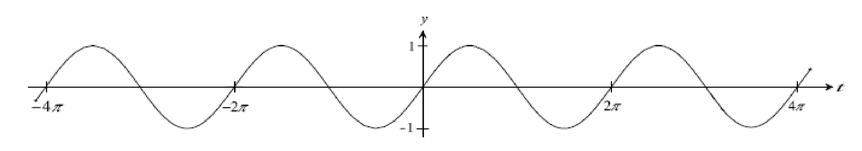
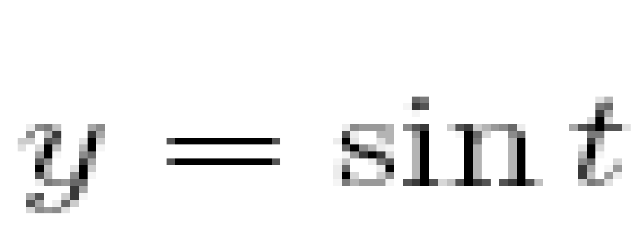
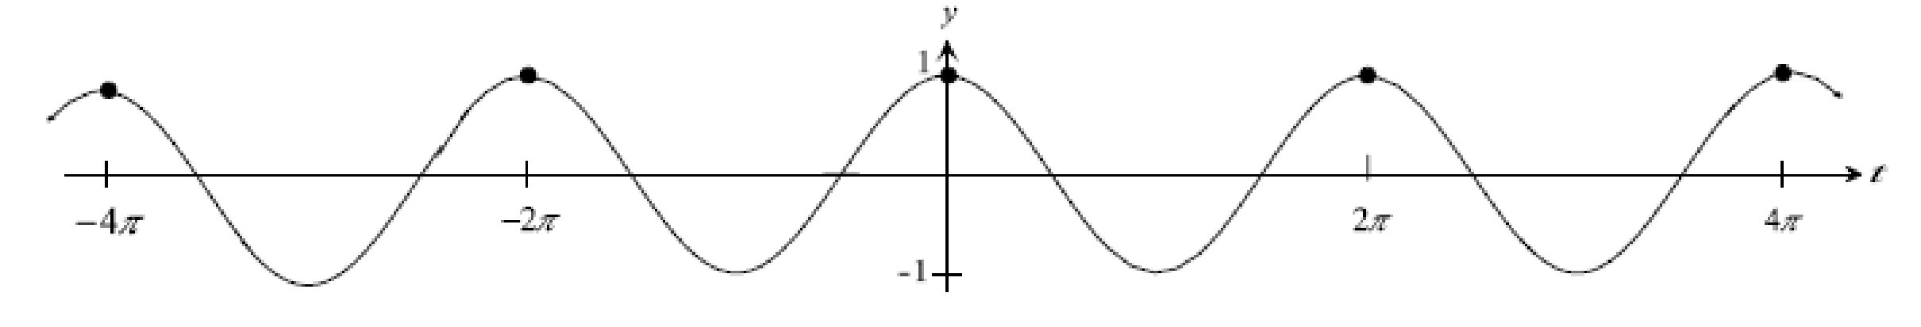
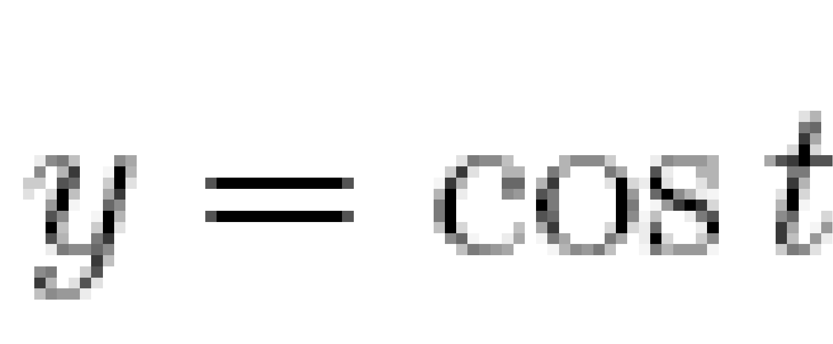
Mathematical Background:
Sine and Cosine Functions
Special case: A=1, b=0, α=1
π
3π/2
π/2
π
π/2
3π/2

Slide 10
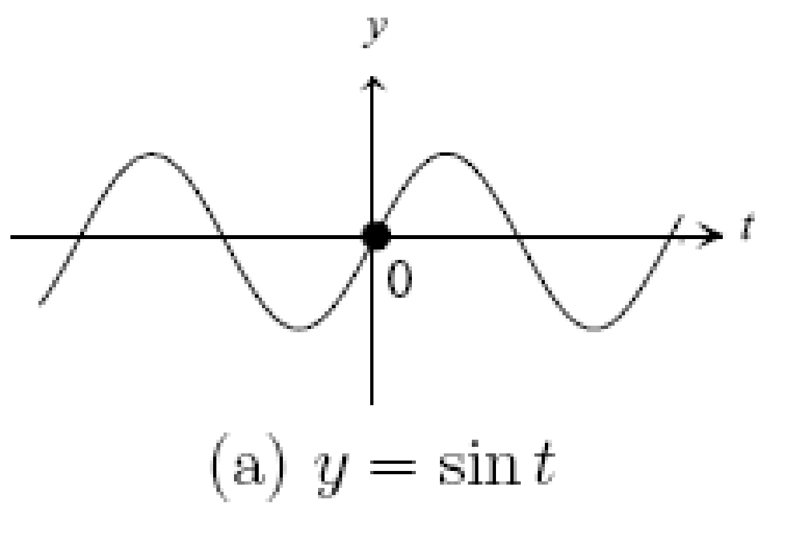
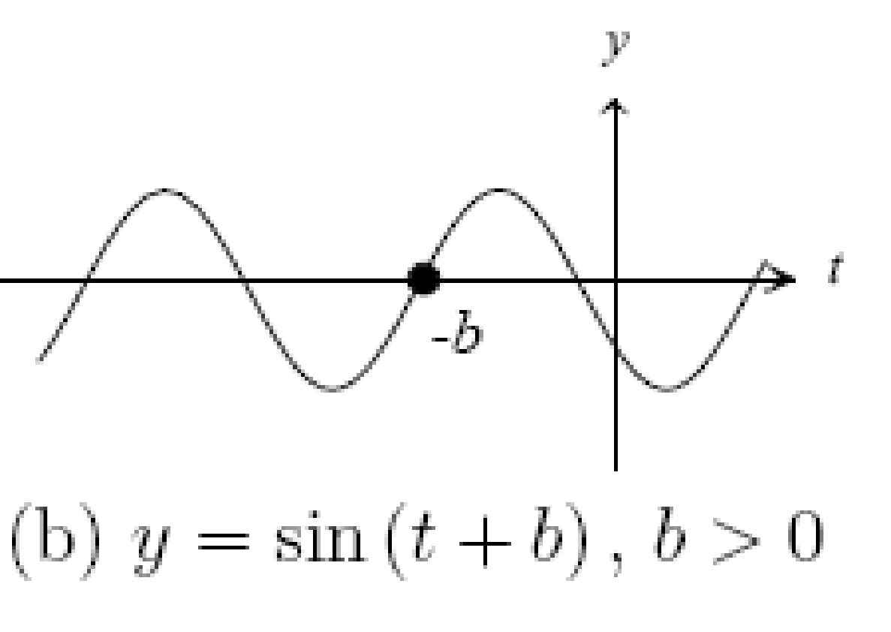
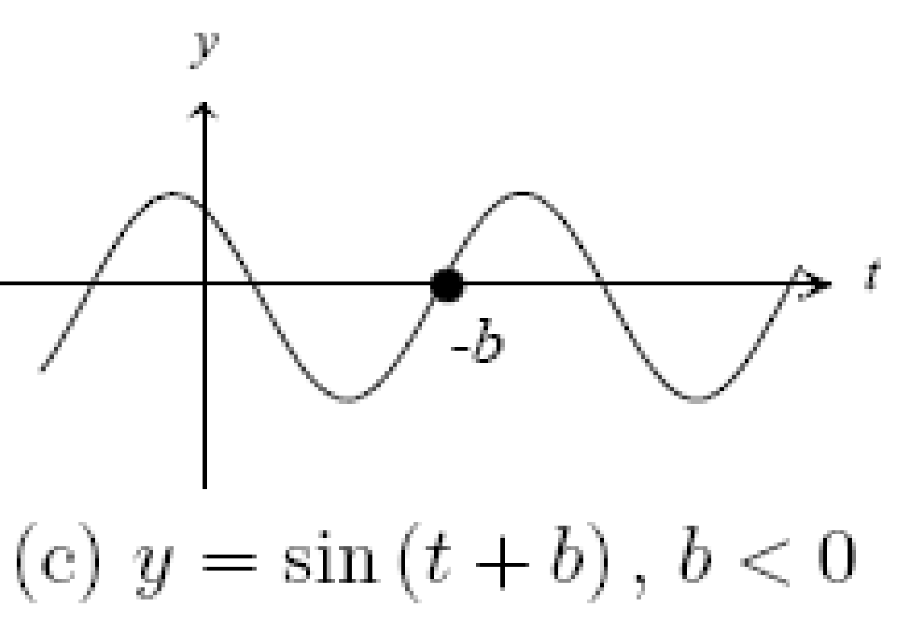
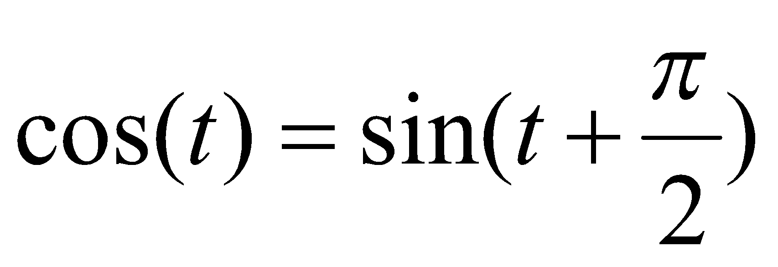
Mathematical Background:
Sine and Cosine Functions (cont’d)
Shifting or translating the sine function by a const b
Note: cosine is a shifted sine function:

Slide 11
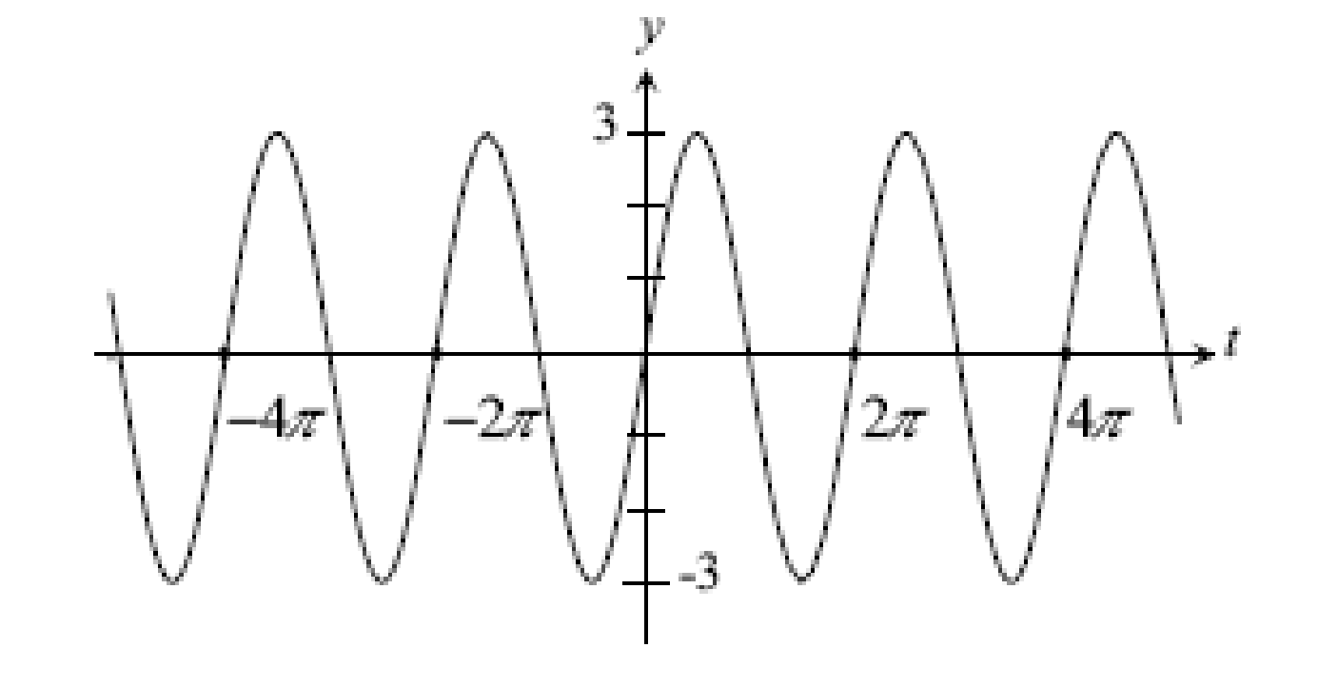
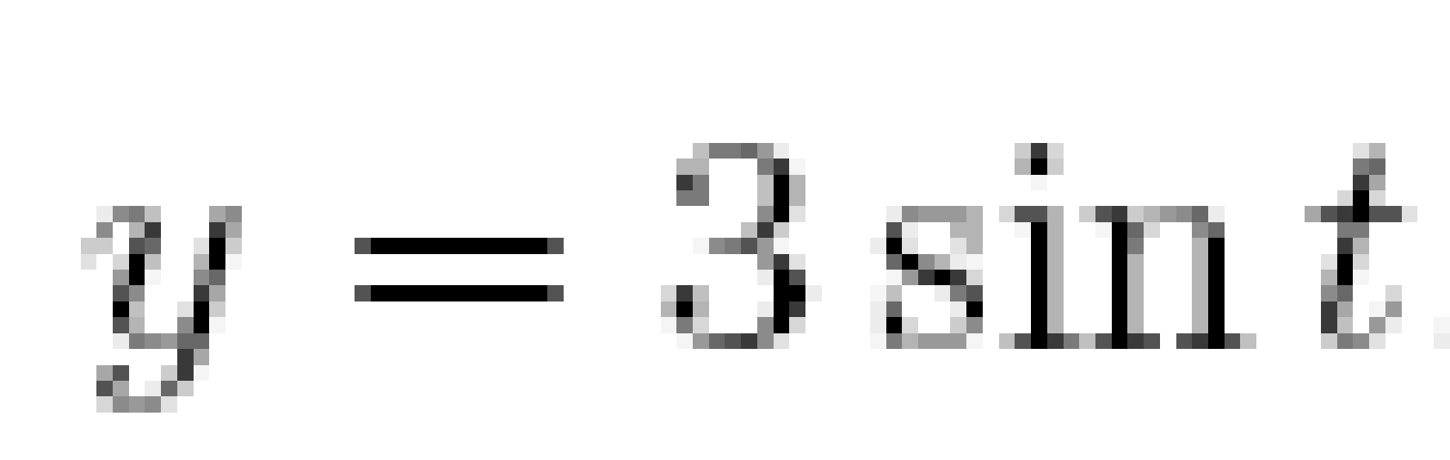
Mathematical Background:
Sine and Cosine Functions (cont’d)
Changing the amplitude A

Slide 12
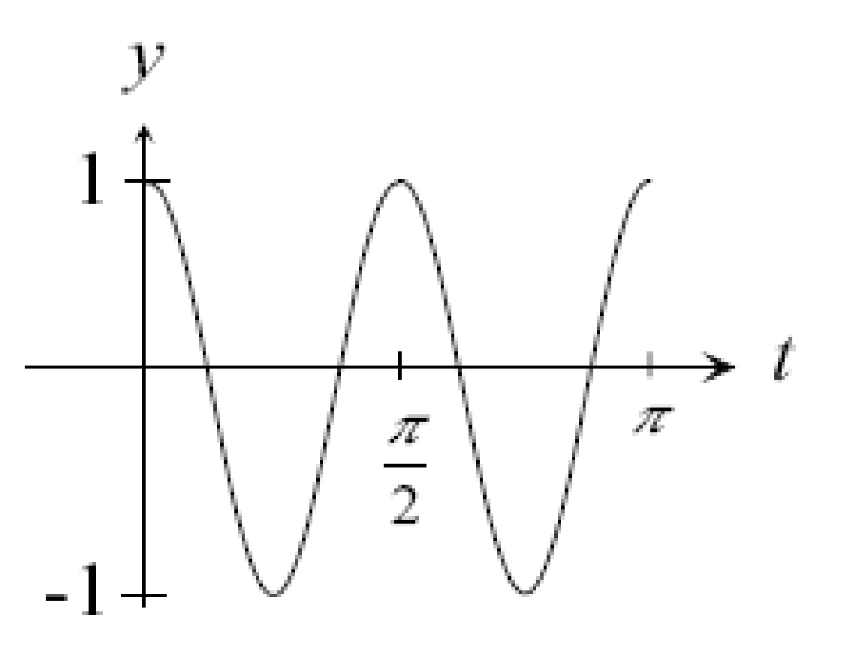
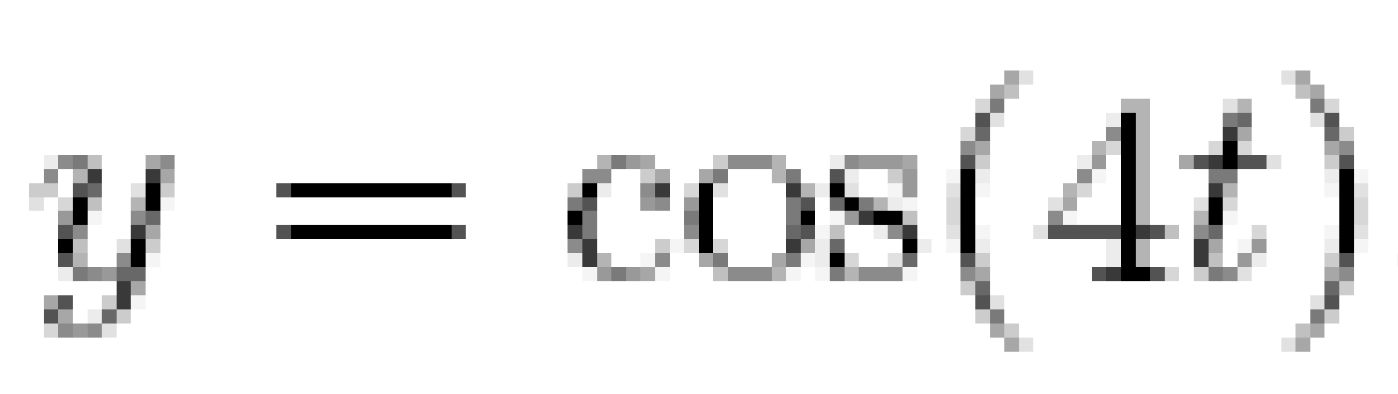
Mathematical Background:
Sine and Cosine Functions (cont’d)
Changing the period T=2π/|α|
consider A=1, b=0: y=cos(αt)
α =4
period 2π/4=π/2
shorter period
higher frequency
(i.e., oscillates faster)
Frequency is defined as f=1/T
Alternative notation: cos(αt)=cos(2πt/T)=cos(2πft)

Slide 13
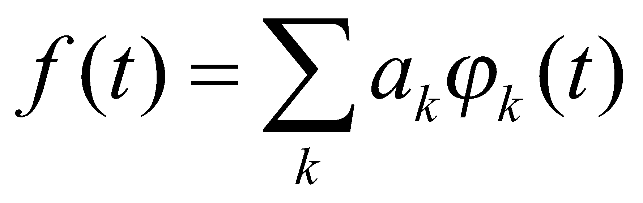
Basis Functions
Given a vector space of functions, S, then if any f(t) ϵ S can be expressed as
the set of functions φk(t) are called the expansion set of S.
If the expansion is unique, the set φk(t) is a basis.

Slide 14
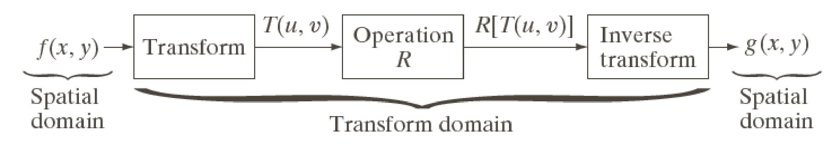
Image Transforms
Many times, image processing tasks are best performed in a domain other than the spatial domain.
Key steps:
(1) Transform the image
(2) Carry the task(s) in the transformed domain.
(3) Apply inverse transform to return to the spatial domain.

Slide 15
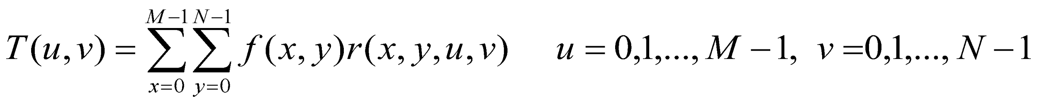
Transformation Kernels
forward transformation kernel
Forward Transformation
Inverse Transformation
inverse transformation kernel

Slide 16
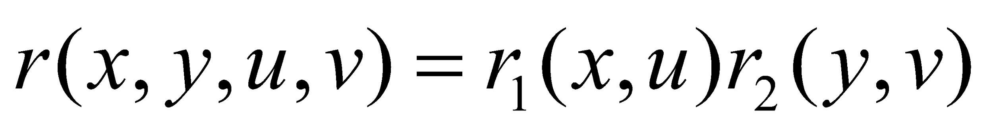
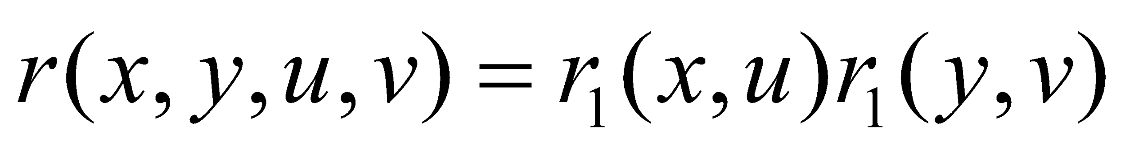
Kernel Properties
A kernel is said to be separable if:
A kernel is said to be symmetric if:

Slide 17
Notation
Continuous Fourier Transform (FT)
Discrete Fourier Transform (DFT)
Fast Fourier Transform (FFT)

Slide 18
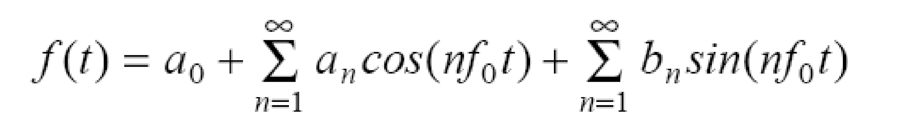


Fourier Series Theorem
Any periodic function f(t) can be expressed as a weighted sum (infinite) of sine and cosine functions of varying frequency:
is called the “fundamental frequency”

Slide 19
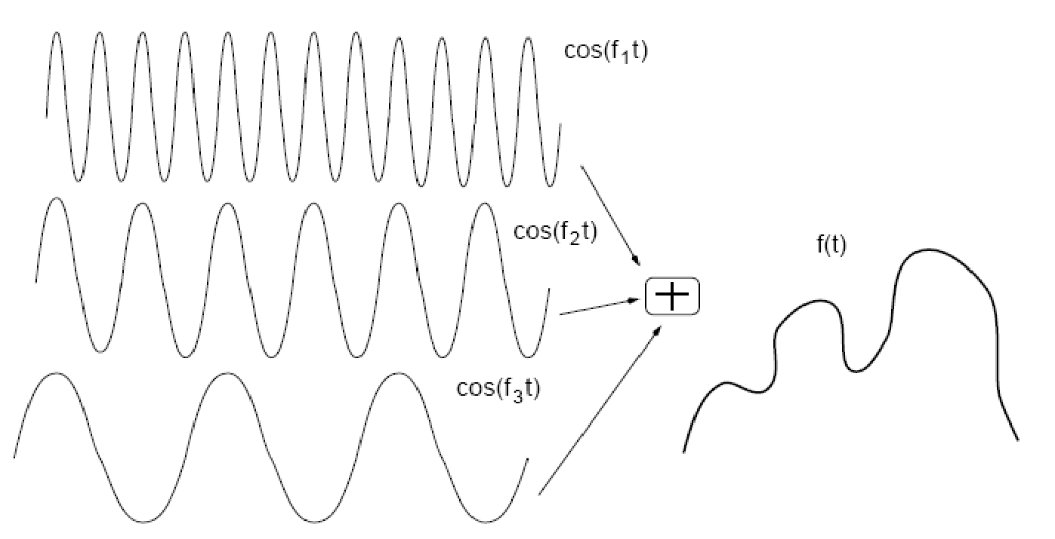
Fourier Series (cont’d)
α1
α2
α3

Slide 20
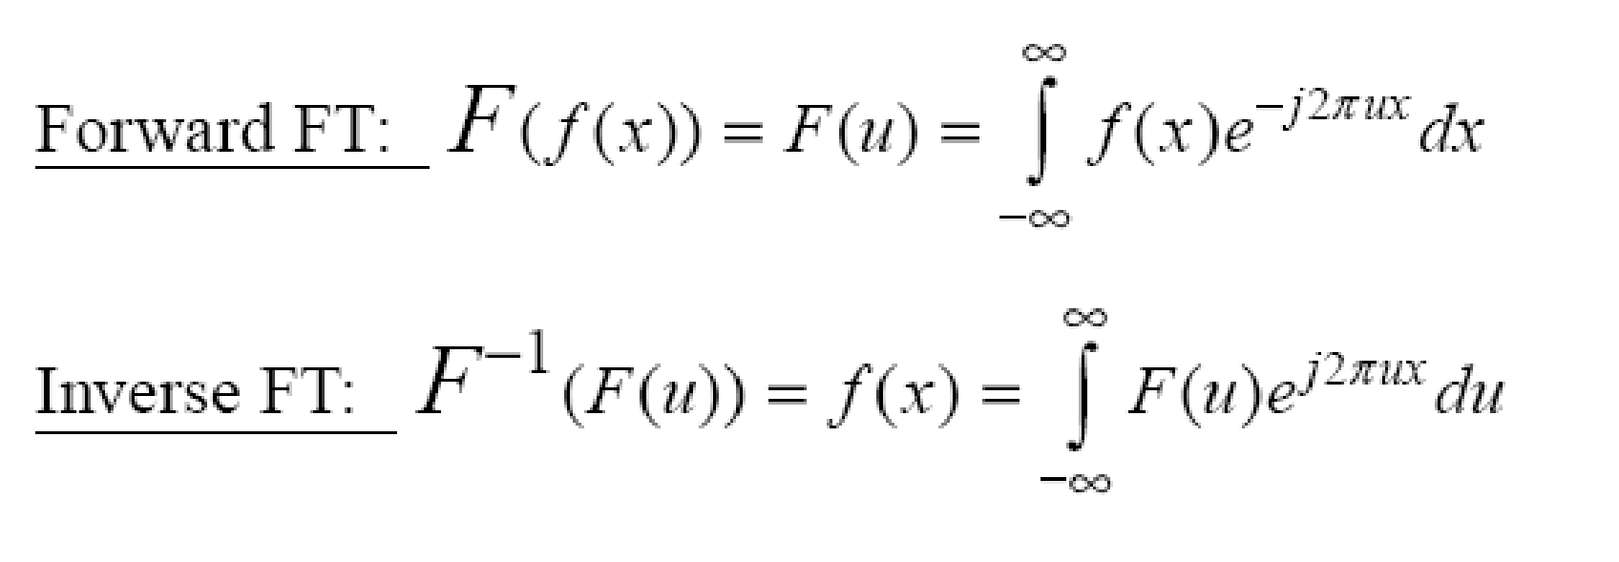
Continuous Fourier Transform (FT)
Transforms a signal (i.e., function) from the spatial (x) domain to the frequency (u) domain.
where

Slide 21
Why is FT Useful?
Easier to remove undesirable frequencies.
Faster perform certain operations in the frequency domain than in the spatial domain.

Slide 22
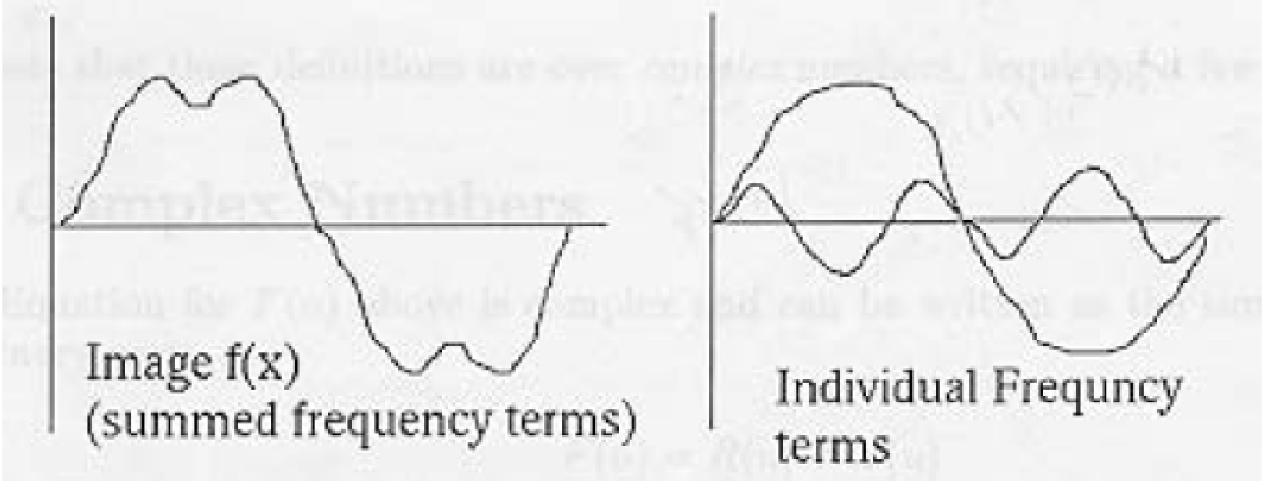
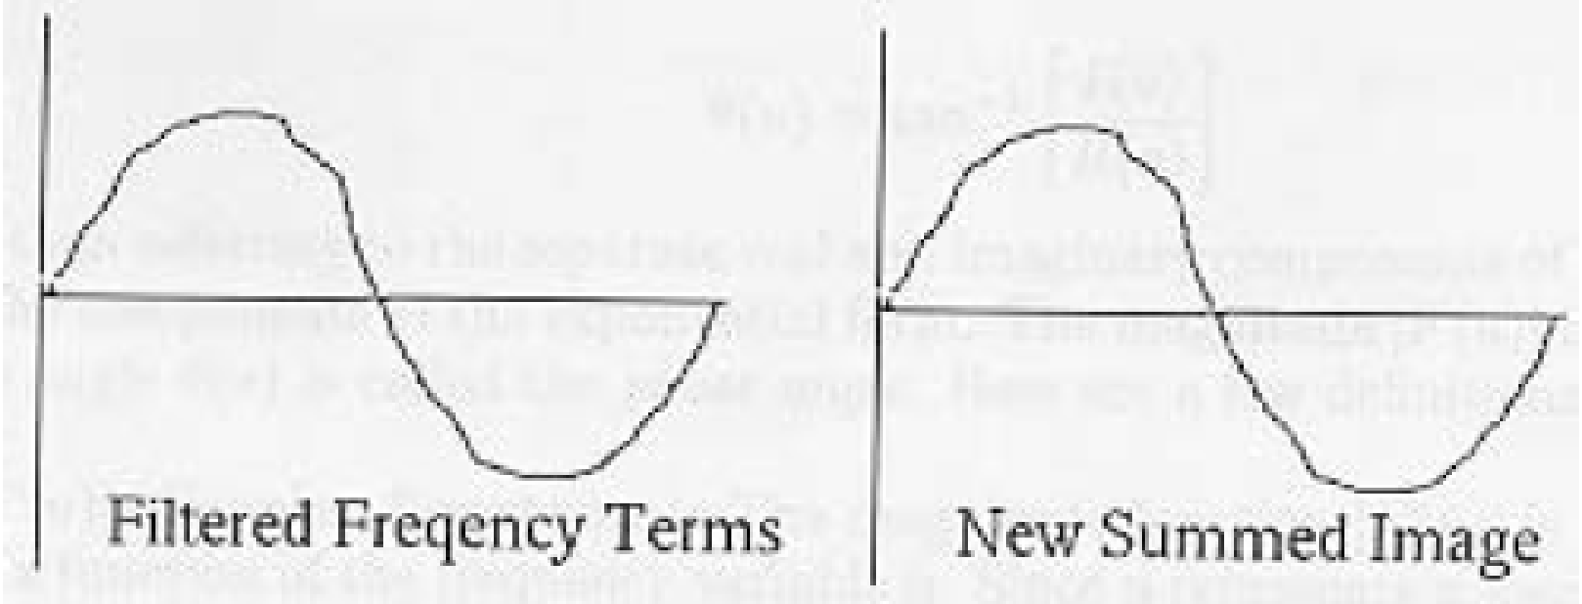
Example: Removing undesirable frequencies
noisy signal
frequencies
To remove certain
frequencies, set their
corresponding F(u)
coefficients to zero!
remove high
frequencies
reconstructed
signal

Slide 23
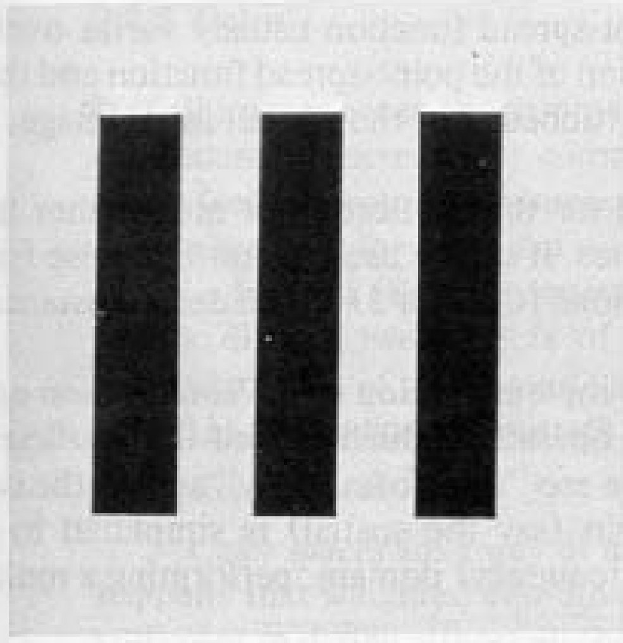
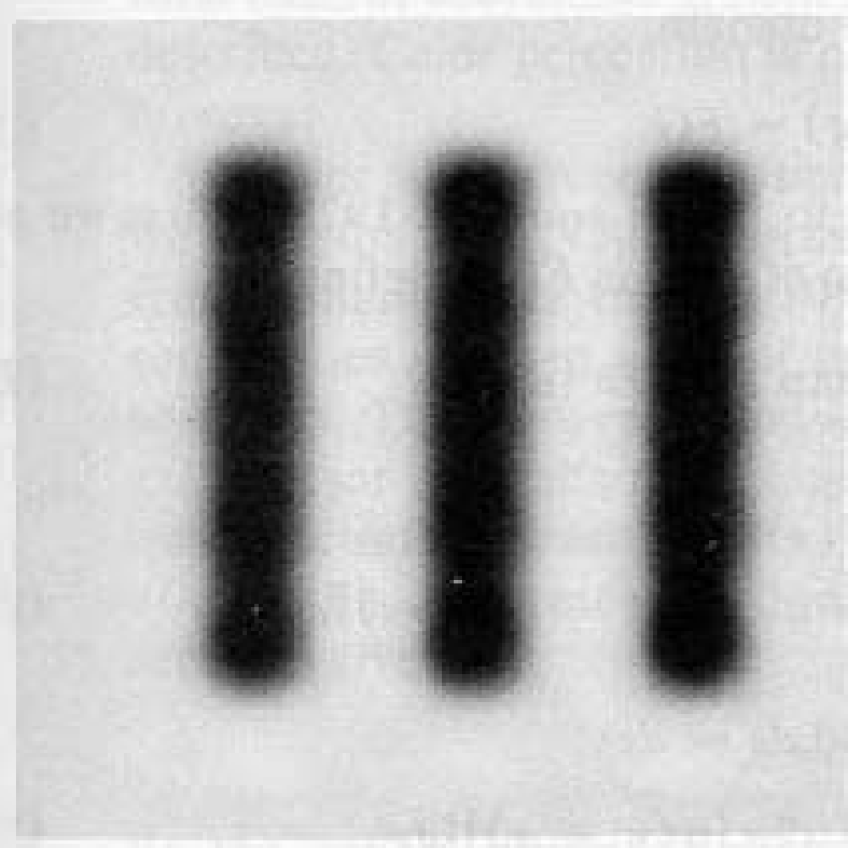
How do frequencies show up in an image?
Low frequencies correspond to slowly varying information (e.g., continuous surface).
High frequencies correspond to quickly varying information (e.g., edges)
Original Image
Low-passed

Slide 24
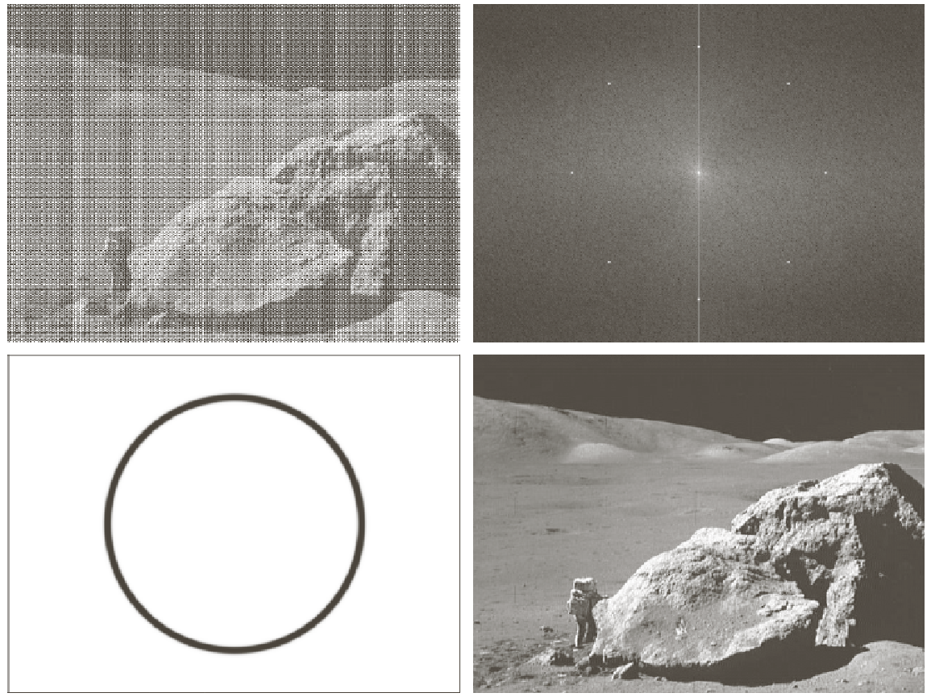
Example of noise reduction using FT
Input image
Spectrum
Band-pass
filter
Output image

Slide 25
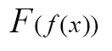
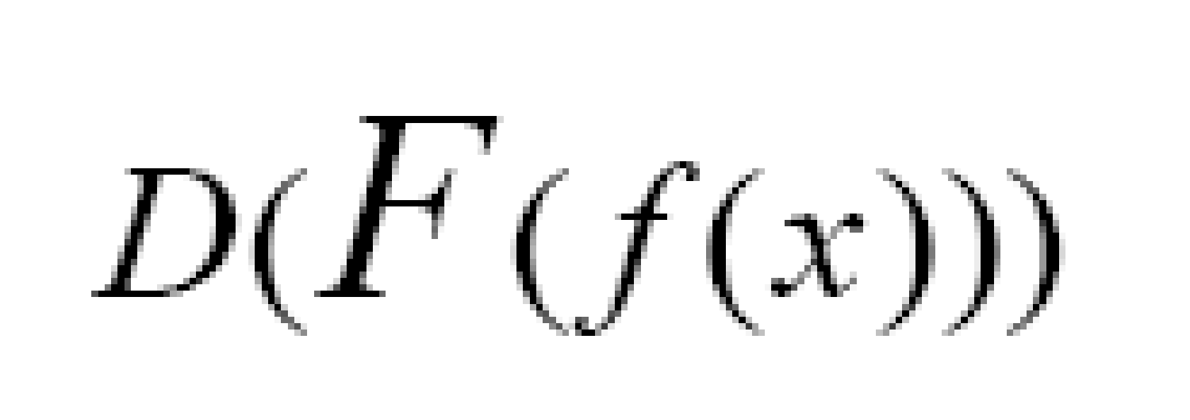
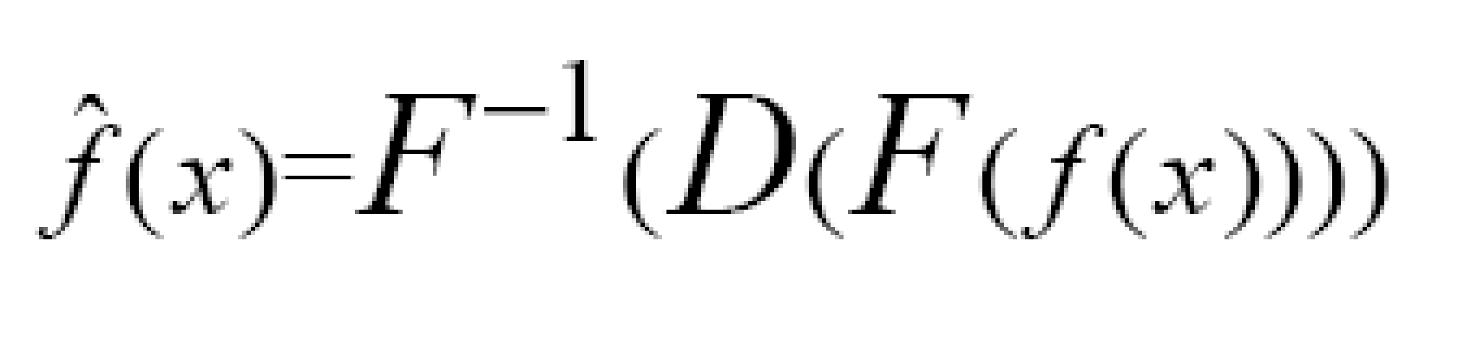
Frequency Filtering Steps
1. Take the FT of f(x):
2. Remove undesired frequencies:
3. Convert back to a signal:
We’ll talk more about these steps later .....

Slide 26
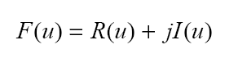
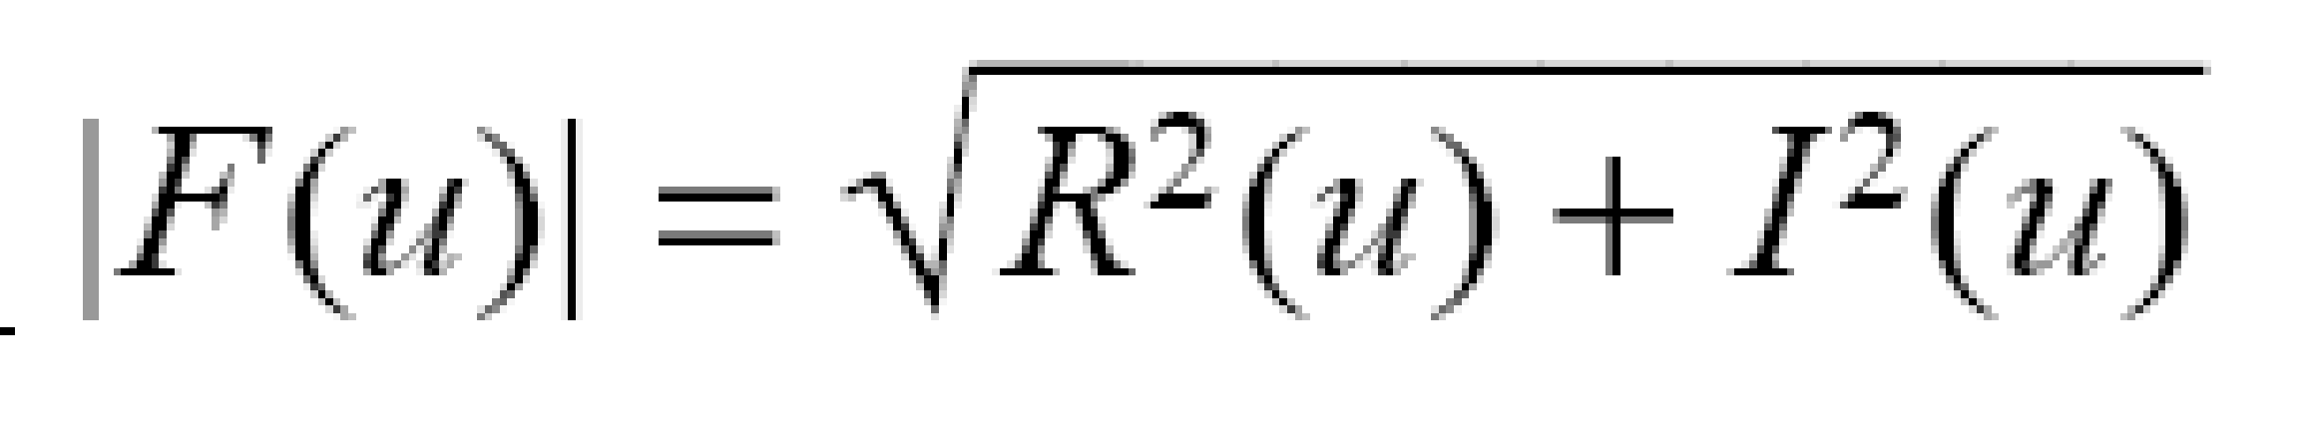
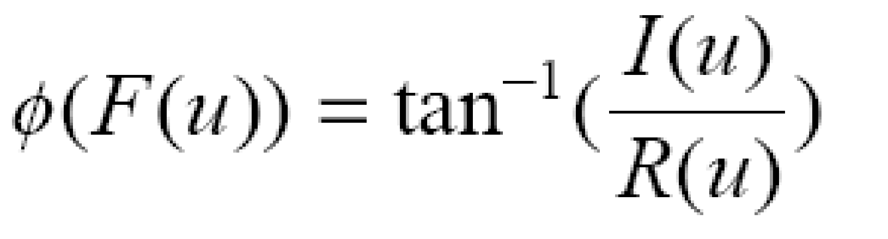
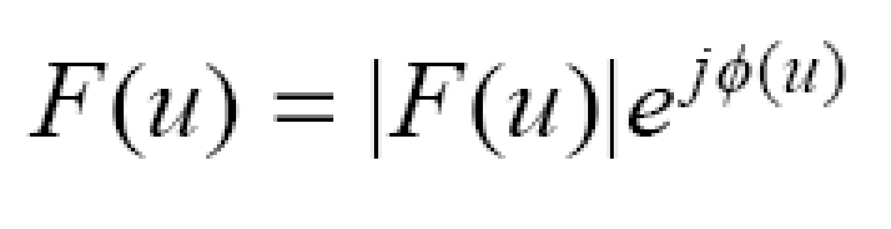
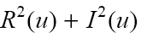
Definitions
F(u) is a complex function:
Magnitude of FT (spectrum):
Phase of FT:
Magnitude-Phase representation:
Power of f(x): P(u)=|F(u)|2=

Slide 27
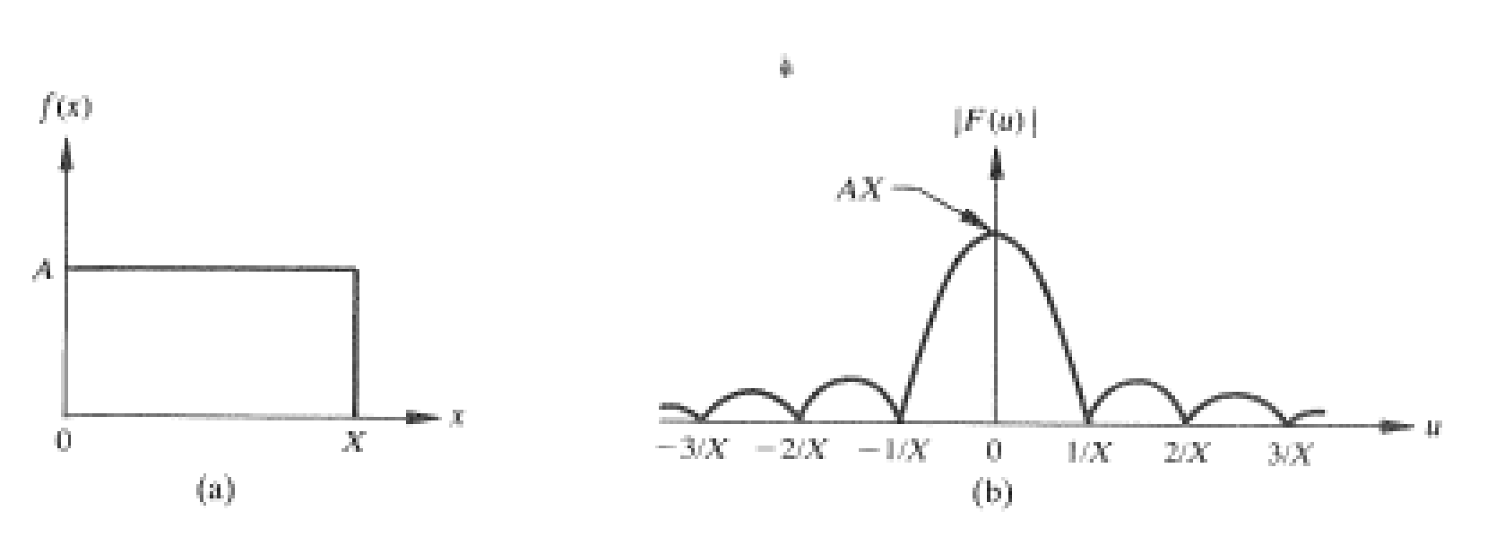
Example: rectangular pulse
magnitude
rect(x) function
sinc(x)=sin(x)/x

Slide 28




Example: impulse or “delta” function
Definition of delta function:
Properties:

Slide 29


Example: impulse or “delta” function (cont’d)
FT of delta function:
1
x
u

Slide 30



Example: spatial/frequency shifts
Special Cases:

Slide 31


Example: sine and cosine functions
FT of the cosine function
cos(2πu0x)
F(u)
1/2

Slide 32


Example: sine and cosine functions (cont’d)
FT of the sine function
-jF(u)
sin(2πu0x)

Slide 33


Slide 34


Slide 35


Slide 36


Slide 37


Slide 38


Slide 39

Discrete
Fourier
Transform
Examples
At all of these examples, the Fourier spectrum is shifted from top left corner to the center of the frequency square.

Slide 40

Discrete
Fourier
Transform
Examples
At all of these examples, the Fourier spectrum is shifted from top left corner to the center of the frequency square.

Slide 41


Slide 42

Discrete
Fourier
Transform
Display
At all of these examples, the Fourier spectrum is shifted from top left corner to the center of the frequency square.

Slide 43



Discrete Fourier Transform
Example
Main Image (Gray Level)
DFT of Main image
(Fourier spectrum)
Logarithmic scaled
of the Fourier spectrum

Slide 44
Basis Vectors and Basis Images
A vector space consists of a set of vectors, a field of scalars, a vector addition operation, and a scalar multiplication operation.
A basis for a vector space ~ a set of vectors
Linearly independent ~ Σ ai vi = 0 if and only if all ai=0
Uniquely represent every vector in the space by their linear combination
~ Σ bi vi ( “spanning set” {vi} )
Orthonormal basis
Orthogonality ~ inner product <x, y> = y*T x= 0
Normalized length ~ || x ||2 = <x, x> = x*T x= 1
Inner product for 2-D arrays
<F, G> = Σm Σn f(m,n) g*(m,n) = G1*T F1 (rewrite matrix into vector)
!! Don’t do FG ~ may not even be a valid operation for MxN matrices!
2D Basis Matrices (Basis Images) 🡸
Represent any images of the same size as a linear combination of basis images

Slide 45
1-D Unitary Transform
Linear invertible transform
1-D sequence { x(0), x(1), …, x(N-1) } as a vector
y = A x and A is invertible
Unitary matrix ~ A-1 = A*T
Denote A*T as AH ~ “Hermitian”
x = A-1 y = A*T y = Σ ai*T y(i)
Hermitian of row vectors of A form a set of orthonormal basis vectors
ai*T = [a*(i,0), …, a*(i,N-1)] T
Orthogonal matrix ~ A-1 = AT
Real-valued unitary matrix is also an orthogonal matrix
Row vectors of real orthogonal matrix A form orthonormal basis vectors
UMCP ENEE631 Slides (created by M.Wu © 2001)

Slide 46
Properties of 1-D Unitary Transform y = A x
Energy Conservation
|| y ||2 = || x ||2
|| y ||2 = || Ax ||2= (Ax)*T (Ax)= x*T A*T A x = x*T x = || x ||2
Rotation
The angles between vectors are preserved
A unitary transformation is a rotation of a vector in an
N-dimension space, i.e., a rotation of basis coordinates
UMCP ENEE631 Slides (created by M.Wu © 2001/2004)
Notes:
Determinant and all eigenvalues have unit magnitude

Slide 47
Properties of 1-D Unitary Transform (cont’d)
Energy Compaction
Many common unitary transforms tend to pack a large fraction of signal energy into just a few transform coefficients
Decorrelation
Highly correlated input elements 🡺 quite uncorrelated output coefficients
Covariance matrix E[ ( y – E(y) ) ( y – E(y) )*T ]
small correlation implies small off-diagonal terms
Question: What unitary transform gives the best compaction and decorrelation?

Slide 48

Unitary Matrix
Definition
conjugate
transpose
A matrix A is called unitary if A-1=A*T
Example
Notes:
∙ transpose and conjugate can exchange, i.e., A*T=AT*
∙ For a real matrix A, it is unitary if A-1=AT

Slide 49




















transform as basis expansion

Slide 50










2-D transforms
2D-DFT and 2D-DCT are separable transforms.

Slide 51


separable 2-D transforms
Symmetric 2D separable transforms can be expressed with the notations of its corresponding 1D transform.
We only need to discuss 1D transforms

Slide 52


Slide 53


Slide 54


DFT Properties: (1) Separability
The 2D DFT can be computed using 1D transforms only:
Forward DFT:
kernel is
separable:

Slide 55


Slide 56

DFT Properties: (1) Separability (cont’d)

Slide 57


DFT Properties: (2) Periodicity
The DFT and its inverse are periodic with period N

Slide 58

Symmetry Properties

Slide 59


Slide 60


Slide 61


Slide 62


Slide 63


DFT Properties: (4) Translation
f(x,y) F(u,v)
Translation in spatial domain:
Translation in frequency domain:
)
N

Slide 64


DFT Properties: (4) Translation (cont’d)
Warning: to show a full period, we need to translate the origin of the transform at u=N/2 (or at (N/2,N/2) in 2D)
|F(u)|
|F(u-N/2)|

Slide 65





DFT Properties: (4) Translation (cont’d)
To move F(u,v) at (N/2, N/2), take
)
N
)
N

Slide 66



DFT Properties: (4) Translation (cont’d)
no translation
after translation

Slide 67


Slide 68




DFT Properties: (5) Rotation
Rotating f(x,y) by θ rotates F(u,v) by θ

Slide 69


Slide 70


DFT Properties: (6) Addition/Multiplication
but …

Slide 71

DFT Properties: (7) Scale

Slide 72


Slide 73



DFT Properties: (8) Average value
Average:
F(u,v) at u=0, v=0:
So:

Slide 74


Slide 75


Slide 76


Slide 77


Slide 78


Slide 79


Slide 80



Magnitude and Phase of DFT
What is more important?
Hint: use the inverse DFT to reconstruct the input image using magnitude or phase only information
magnitude
phase

Slide 81


Magnitude and Phase of DFT (cont’d)
Reconstructed image using
magnitude only
(i.e., magnitude determines the
strength of each component!)
Reconstructed image using
phase only
(i.e., phase determines
the phase of each component!)

Slide 82

Magnitude and Phase of DFT (cont’d)

Slide 83

Discrete Cosine transform

Slide 84


Slide 85


Slide 86



Slide 87


Discrete Cosine Transform

Slide 88

Why DCT not FFT?
DCT is similar to the Fast Fourier Transform (FFT), but can approximate lines well with fewer coefficients

Slide 89


Slide 90
The basic operation of the DCT is as follows:
The input image is N by M;
f(i,j) is the intensity of the pixel in row i and column j;
F(u,v) is the DCT coefficient in row k1 and column k2 of the DCT matrix.
For most images, much of the signal energy lies at low frequencies; these appear in the upper left corner of the DCT.
Compression is achieved since the lower right values represent higher frequencies, and are often small - small enough to be neglected with little visible distortion.
The DCT input is an 8 by 8 array of integers. This array contains each pixel's gray scale level
8 bit pixels have levels from 0 to 255.

Slide 91
Is DCT and Spatial filtering are same?
It is computationally easier to implement and more efficient to regard the DCT as a set of basis functions which given a known input array size (8 x 8) can be precomputed and stored.
This involves simply computing values for a convolution mask (8 x8 window) that get applied (summ values x pixel the window overlap with image apply window across all rows/columns of image). The values as simply calculated from the DCT formula

Slide 92


Slide 93

Discrete Cosine Transform (DCT)
Each block consists of 4×4 elements, corresponding to x and y varying from 0 to 3. The highest value is shown in white. Other values are shown in grays, with darker meaning smaller.

Slide 94

Two dimensional DCT basis functions (N = 8). Neutral gray represents zero, white represents positive amplitudes, and black represents negative amplitude

Slide 95


Slide 96
8*basis function image shows combination of horizontal and vertical frequencies for an 8 x 8 two-dimensional DCT.
Each step from left to right and top to bottom is an increase in frequency by 1/2 cycle.
For example, moving right one from the top-left square yields a half-cycle increase in the horizontal frequency.
Another move to the right yields two half-cycles.
A move down yields two half-cycles horizontally and a half-cycle vertically.
The source data (8x8) is transformed to a of these 64 frequency squares.

Slide 97


Slide 98


Example
large areas of slowly varying intensities.

Slide 99

contains a number of edges (i.e., sharp intensity variations) and therefore can be classified as a high frequency image with low spatial content.

Slide 100


are images with progressively high frequency and spatial content.

Slide 101

shows periodicity therefore the DCT contains impulses with amplitudes proportional to the weight of a particular frequency in the original waveform.

Slide 102


Slide 103


Slide 104


Slide 105


Slide 106


Slide 107

Examples
Let's look at two examples. The 8 x 8 matrix A below contains only the value 100.
The DCT B=CACT appears below:

Slide 108

Note that the entire block, save the (1,1) element, was converted to 0.
Let's have a look at another example. The 8 x 8 matrix A below contains only the values 50, 51, and 52. As far as images go, we would consider this a region where there is little change in gray intensities.

Slide 109


The DCT (rounded to three digits) of the near-constant matrix appears below. Note that many of the values are close to zero.

Slide 110





Slide 111


This image was reconstructed with 1 coefficient (that is, 1/64):
This image was reconstructed with 3% of the coefficients:

Slide 112

This image was reconstructed with 34% of the coefficients:
It is difficult to see any difference between the 34% image and the original, because we have thrown away information that is less important for the eye. Artifacts are visible in the 3% image, but at first glance it is a very reasonable representation of the original image.

Slide 113
Important conclusions:
The coefficient that scales the constant basis function (u = 0,v=0) is called the DC coefficient, while the other coefficients are called AC coefficients.
Note that the DC term gives the average over the set of samples.
Furthermore, the DC term is usually a great deal larger in magnitude than the AC terms and as the elements move farther away from the DC term, they tend to become lower and lower in value.
Recall that the AC terms farther away from the DC term represent coefficients of waveforms of greater spatial frequencies.

Slide 114
Important conclusions continued..
The fact that these coefficients tend to be smaller in magnitude suggests that higher-frequency image components play a relatively small role in the determining picture quality, while the majority of image definition comes from lower-frequency image components.
This idea becomes extremely important when applied two-dimensionally to an image, for JPEG exploits this exact concept when deciding what information can be eliminated to achieve compression

Slide 115
By performing the DCT on the input data, we have concentrated the representation of the image in the upper left coefficients of the output matrix, with the lower right coefficients of the DCT matrix containing less useful information.
The next step, quantization of the coefficients in the output matrix, "discards" the less useful data and in turn compresses the image data.

Slide 116

DCT Example

Slide 117

Block wise DCT Example

Slide 118







DFT and DCT on Lena
DFT2
DCT2
Shift low-freq to the center
Assume periodic and zero-padded …
Assume reflection …

Slide 119
LL1 | HL1 |  | LL2 | HL2 | HL1
LH2 | HH2
LH1 | HH1 | LH1 | HH1
First level
Second level
LL3 | HL3 | HL2 | HL1
LH3 | HH3
LH2 | HH2
LH1 | HH1
Most important part of the image
EE lab.530
Third level

Slide 120
Example:
20 | 15 | 30 | 20 |  | 35 | 50 | 5 | 10
17 | 16 | 31 | 22 | 33 | 53 | 1 | 9
15 | 18 | 17 | 25 | 33 | 42 | -3 | -8
21 | 22 | 19 | 18 | 43 | 37 | -1 | 1
Original image O
1st horizontal separation
68 | 103 | 6 | 19 |  | 326 | -38 | 6 | 19
76 | 79 | -4 | -7 | 16 | -32 | 2 | -7
2 | -3 | 4 | 1 | 2 | -3 | 4 | 1
-10 | 5 | -2 | -9 | -10 | 5 | -2 | -9
1st vertical separation
2nd level DWT result
EE lab.530

Slide 121


Original
Image
LL
HL
LH
HH
EE lab.530

Slide 122


LL2
HL2
HL
LH2
HH2
LH
HH
LL3
HL3
HL2
HL
LH3
HH3
LH2
HH2
LH
HH
EE lab.530

Slide 123

Comparison Of Various Transforms

Slide 124

Comparison Of Various Transforms

